Slide 1
Mobile App Architecture
The foundations of app development

Slide 2
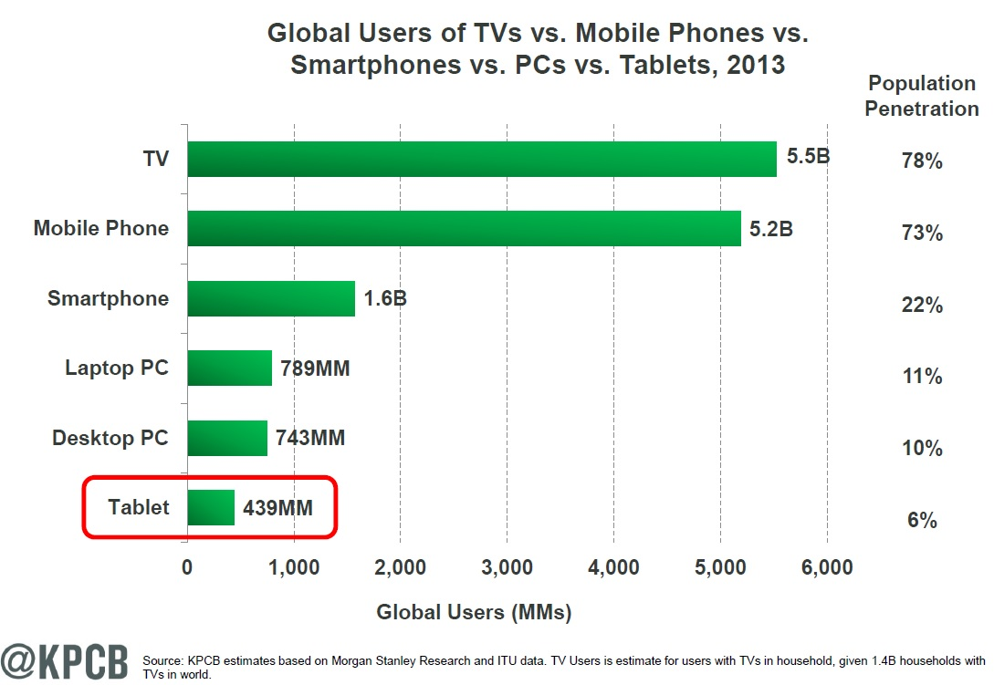
Why Mobile?
Source: KPCB

Slide 3
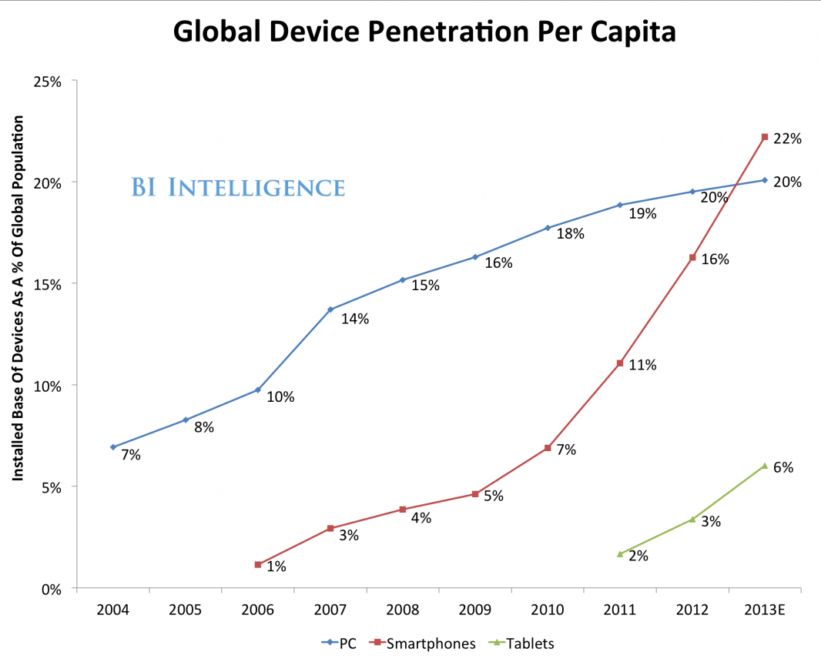
Why Mobile?
2005
PC: 8%
SP: <1%
TB: <1%
2015
PC: 21%
SP: 30%
TB: 6%

Slide 4
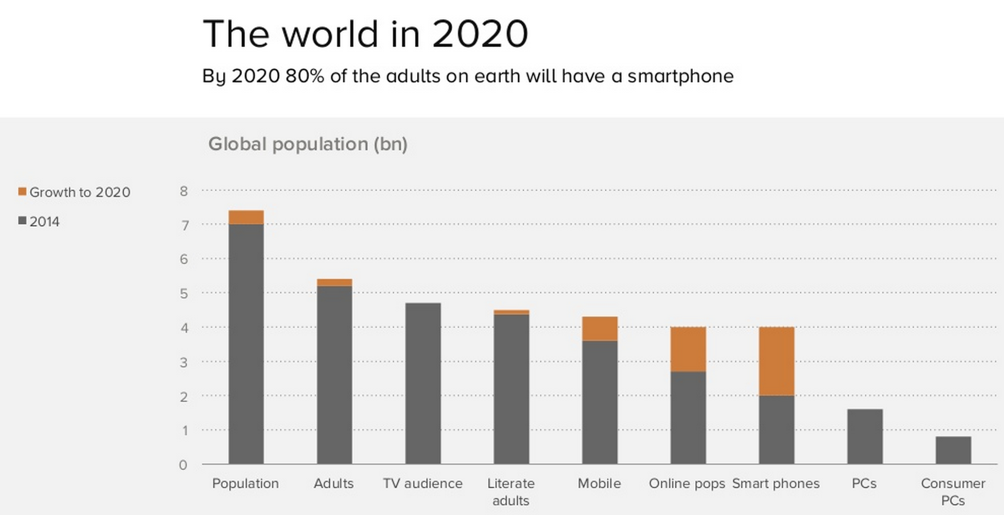
Why Mobile?

Slide 5
Why Mobile?
Here are a few key facts:
As of Jan 2015, 1.8B people own a smartphone. Up 25% since 2013.
About 1 out every 4 human beings on earth today uses a smartphone.
Mobile internet usage will overtake desktop internet usage in 2015.

Slide 6
Types of Mobile Apps
Broadly, there are two categories of mobile apps available:
View-heavy data-driven
Email, Social, News, Todo
Graphics-heavy drawing
Games, Creative Art, Photo Editing

Slide 7
Types of Mobile Apps
We are focusing on data-driven apps. Why?
Control-based data driven apps are the bread and butter of mobile development
Instagram, Facebook, Pinterest, Twitter
Complex drawing-based apps are more specialized and tend to be more advanced.

Slide 8
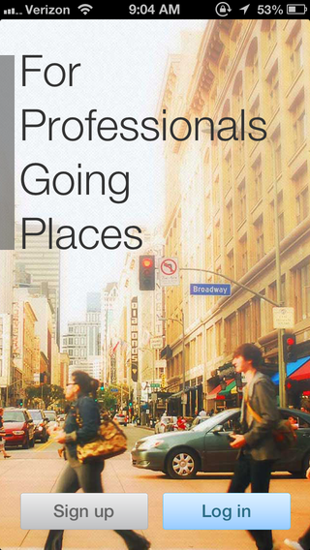

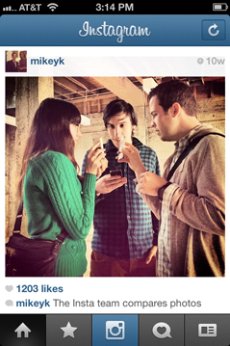
Mobile Apps (iOS)

Slide 9
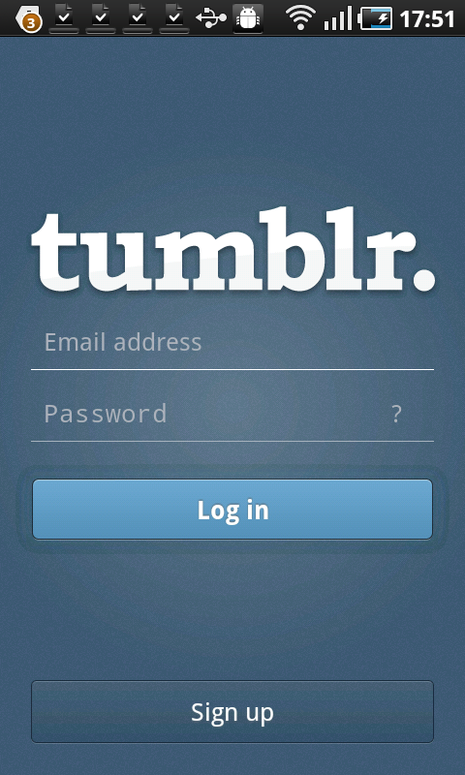
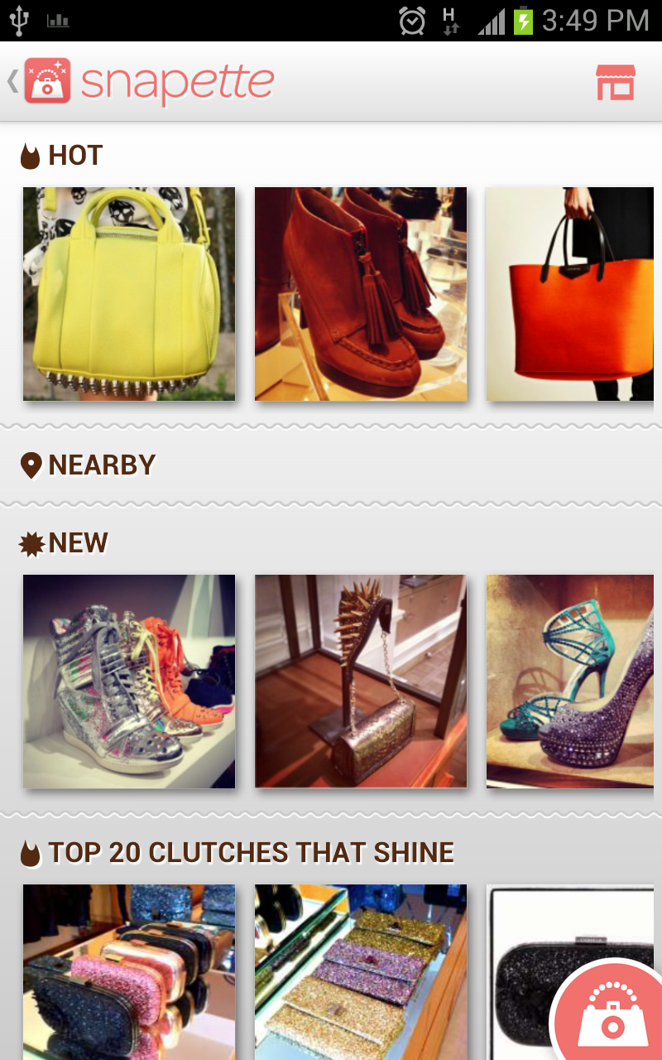
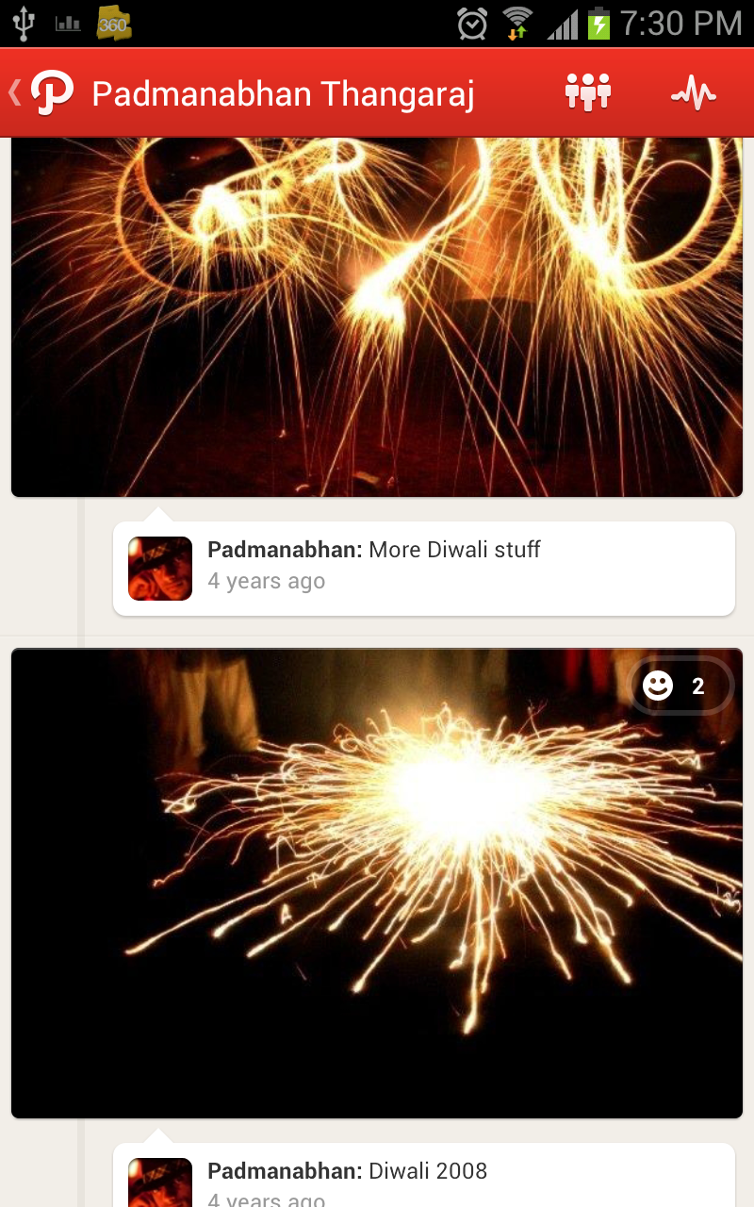
Mobile Apps (Android)

Slide 10
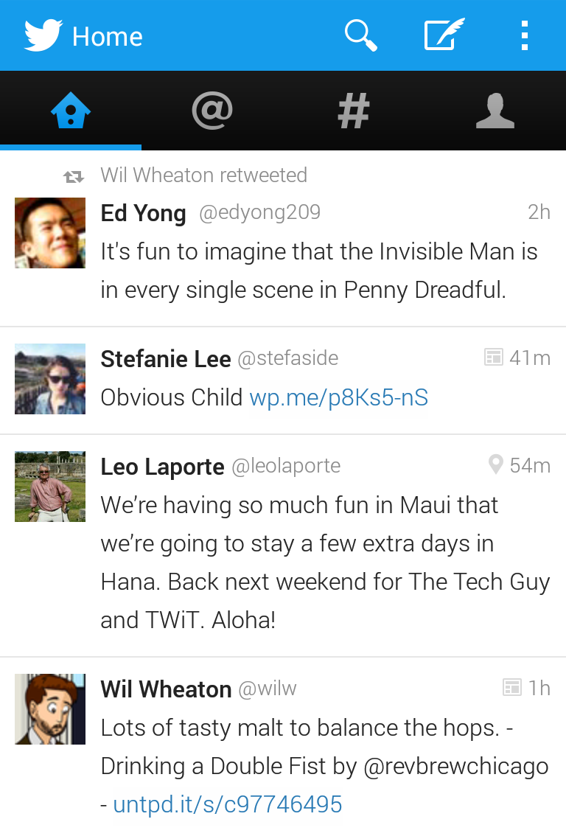
App Breakdown
What specific topics would we need to implement the Twitter or Facebook app ourselves?
How to add action icons i.e compose?
How to insert clickable hyperlinks?
???

Slide 11
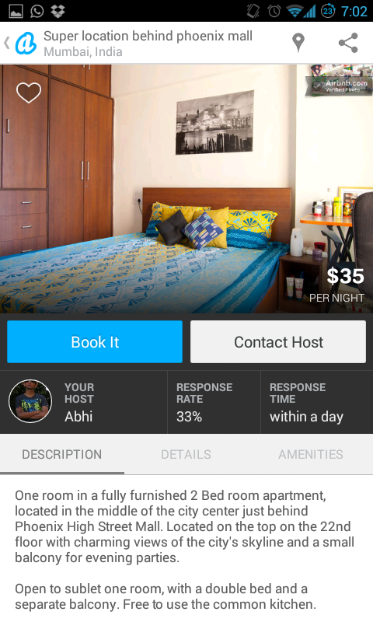
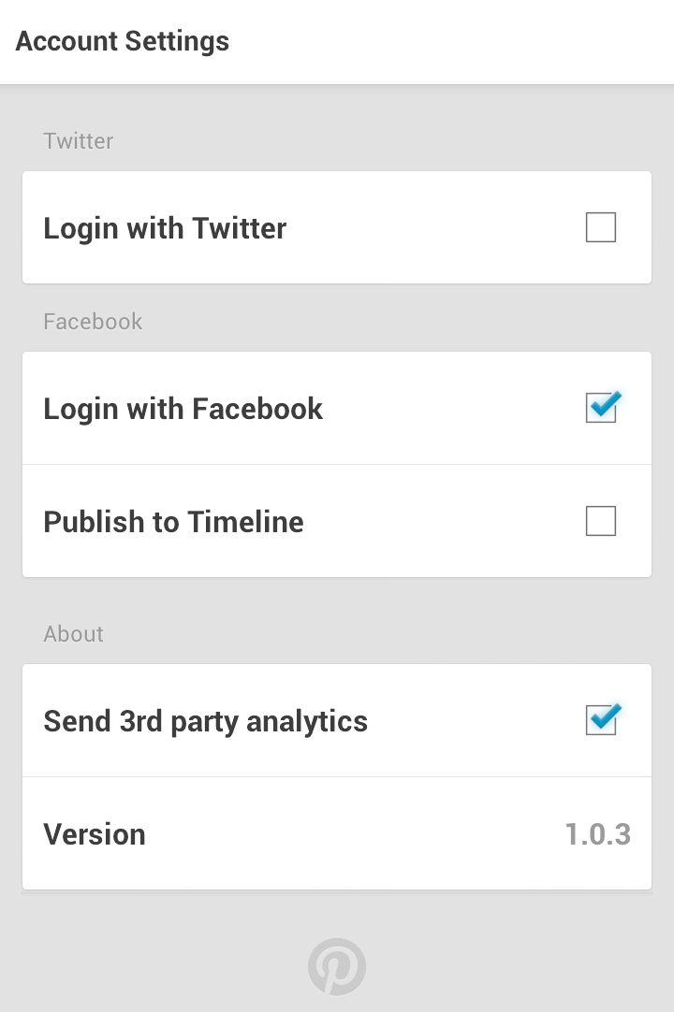
Screen Archetypes
What does a typical data-driven app look like?
What are the most common screens?

Slide 12
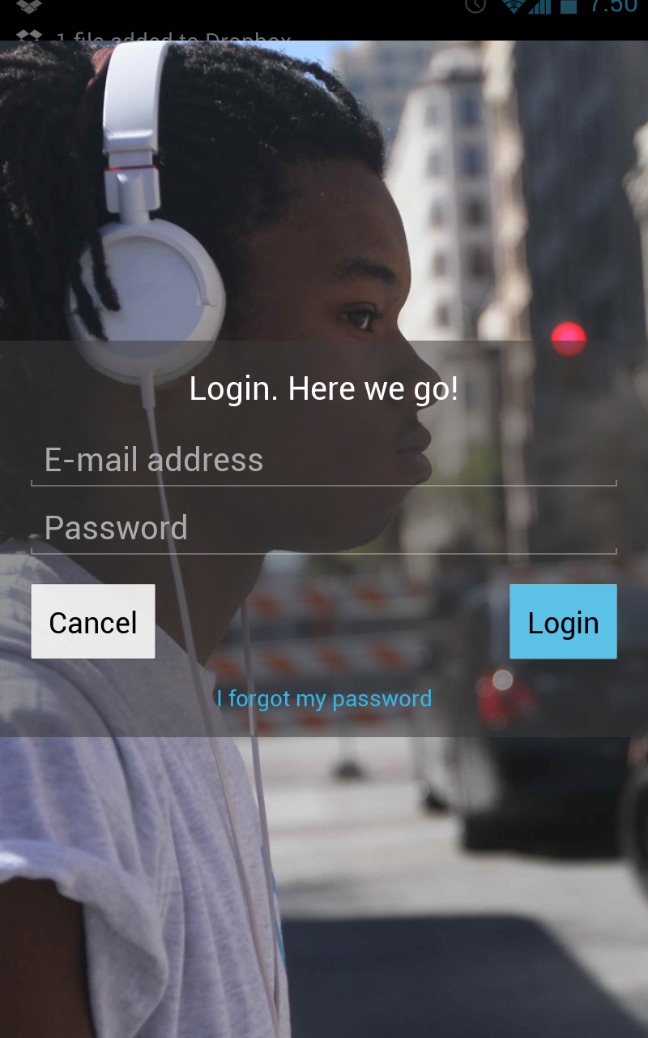
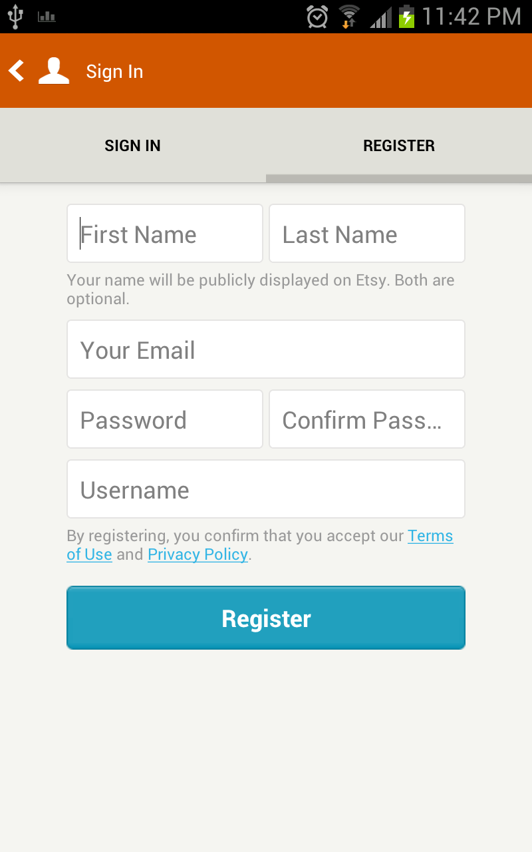
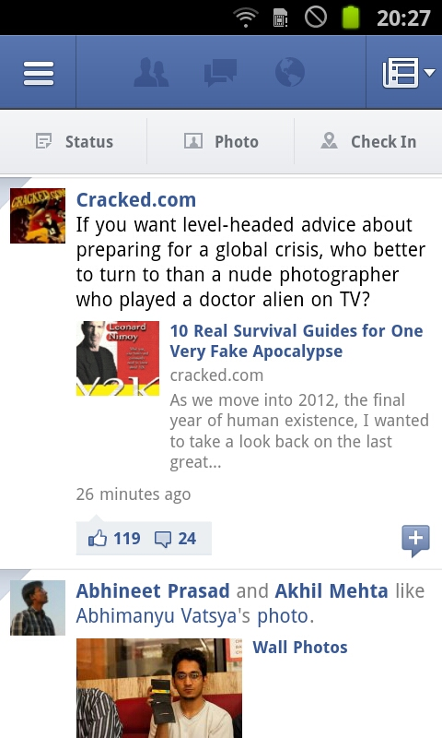
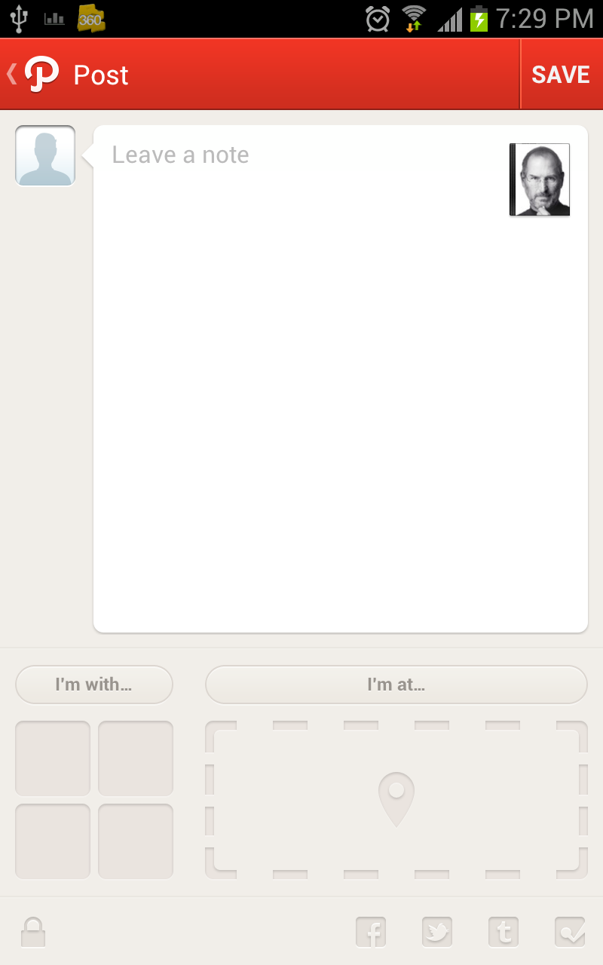
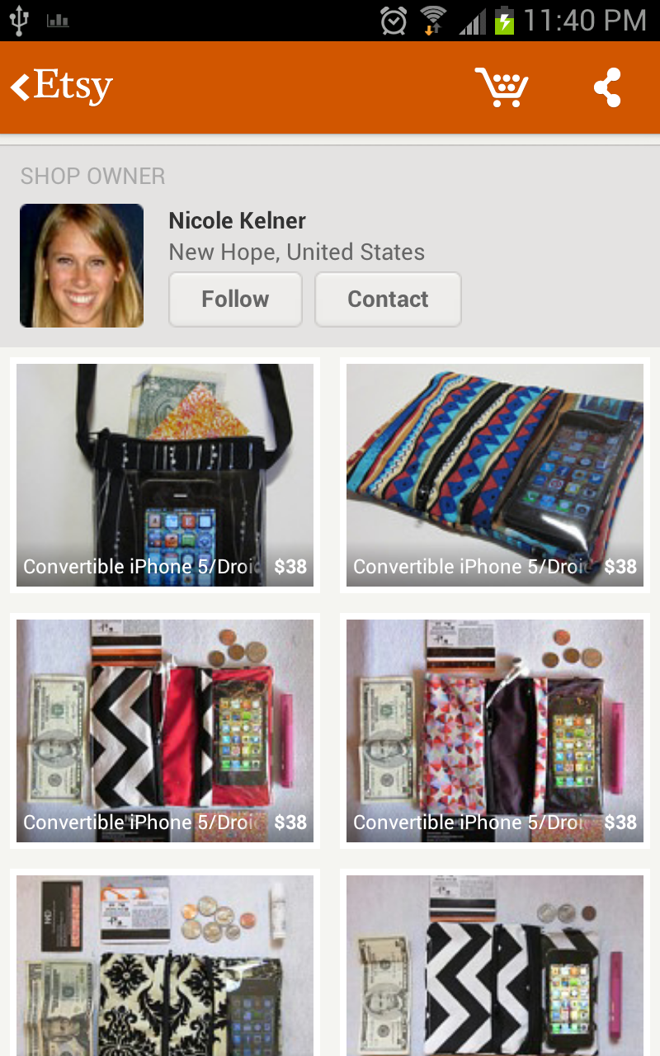
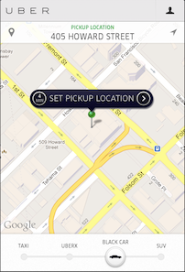
Screen Archetypes

Slide 13
Screen Archetypes
Login
Register
Stream
Detail
Creation
Profile
Settings
Maps

Slide 14
Application Architecture
Learning to build real data-driven apps requires a few core concepts.
Views: Common Controls and View Layout
Events: Interaction and Event Handling
Navigation: Screen Flows and Navigation
Data: Models, Networking and Persistence
Platform: OS Services, Hardware, Accessing Sensors

Slide 15
Mobile Client Architecture
Views
Controllers
Models
Networking
Authentication
OS Foundations
UI Core, Event Loop, System Components
Device Hardware
GPS, Accelerometer, Bluetooth

Slide 16
Application Architecture
Real data-driven apps usually require an API.
Apps display data and this comes from a source.
Most mobile apps rely on server-side APIs for data.
When developing mobile, consider what sources your app's data is coming from / being saved to.
Many apps leverage existing APIs while others require a custom server-side component.

Slide 17
Application Architecture
Views
Initiate OAuth Session
Request API Data
Modify Data via API
API Responses
Controllers
Models
Controllers
Models
Networking
Authentication
OAuth Authentication Layer
OS Foundations
Web Application
Send OAuth Token
Send API Data
Send Images/Video
Device Hardware
Database
Mobile App
Server API

Slide 18
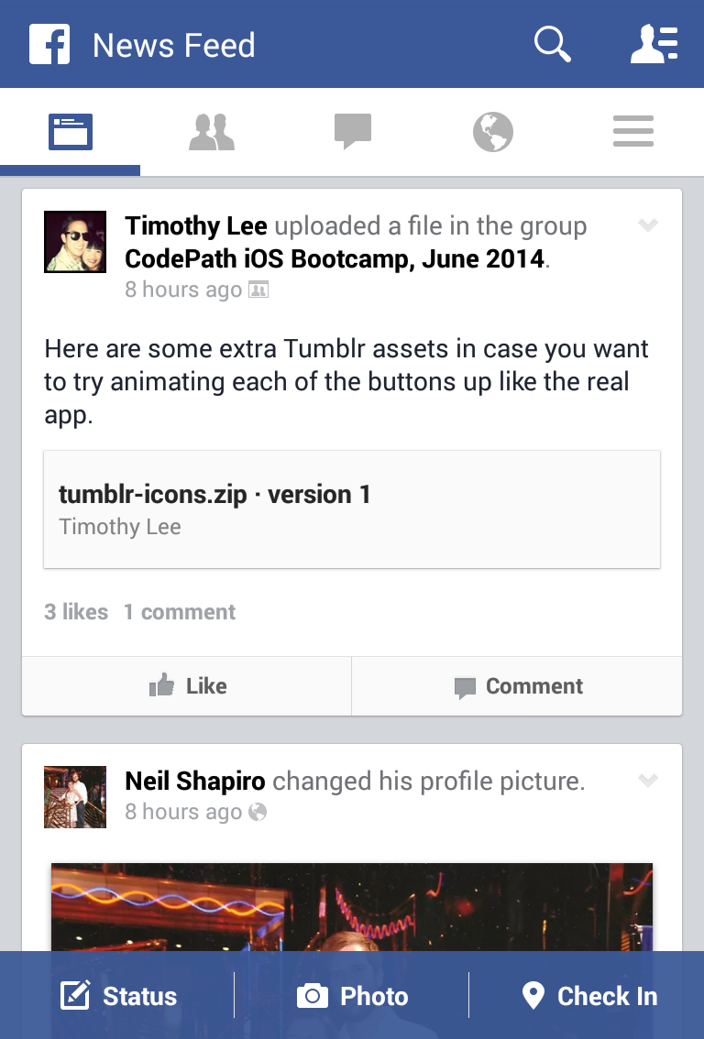
Views
Views display data or receive data inputs.
What static views can you not implement with a scrollable view, labels, images, buttons, and maps?
What form can you not implement with text inputs, switches, buttons, and sliders?

Slide 19
Controllers
Controllers work with views and models to implement dynamic behaviors including:
Network requests (API interaction)
Persistence (Storing data)
Event handling (Button clicks, Data Input)
Navigation (Moving between app views)

Slide 20
Models
Models on mobile usually reflect the server state for data retrieved via APIs including:
Model definitions (properties, relationships)
JSON/XML serialization/deserialization
Persistence Storage (database)
Data Formatters

Slide 21
Networking
Networking on mobile means interacting with a server in one of the following ways:
Interacting with models via a REST API
Displaying external images in the view
Audio/video playback
Socket programming (rare)

Slide 22
Hardware
Leveraging device features including:
Camera
GPS
Accelerometer
Bluetooth, AirDrop
Contacts, Calendar, SMS, Mail

Slide 23
Architecture Review
In summary, we have reviewed:
Mobile is growing fast and demand is high
We are focusing on data-driven app development
Data-driven apps require a server-side API
All mobile development has a consistent architecture
Mobile largely is MVC + Networking + Hardware

